Slide 1
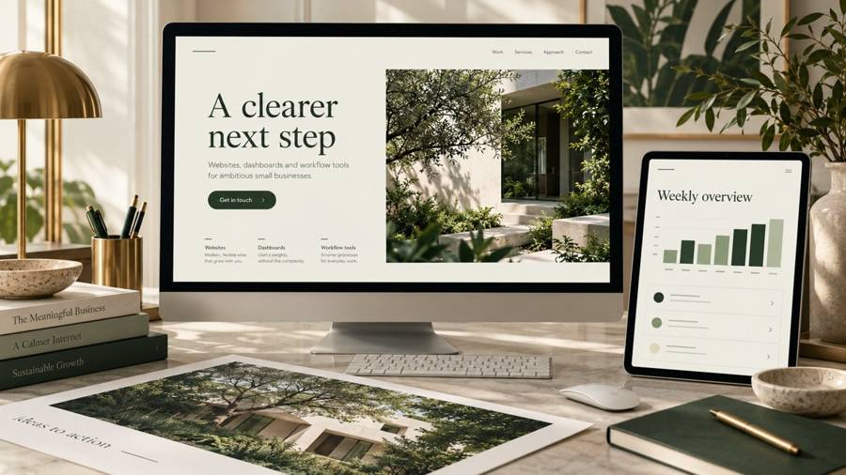
AI PROBLEM DESK
CEDAR STUDIO
A clearer way to run the work
An illustrative project portfolio for a fictional design business. Built samples by AI Problem Desk.
Fictional business sample. No client results claimed.
01
Notes:
Created demonstration by AI Problem Desk. Cedar Studio is fictional. Generated visual concepts are illustrative. No client testimonial, measured commercial result, or confidential client material is represented. Website: https://aiproblemdesk.com/

Slide 2
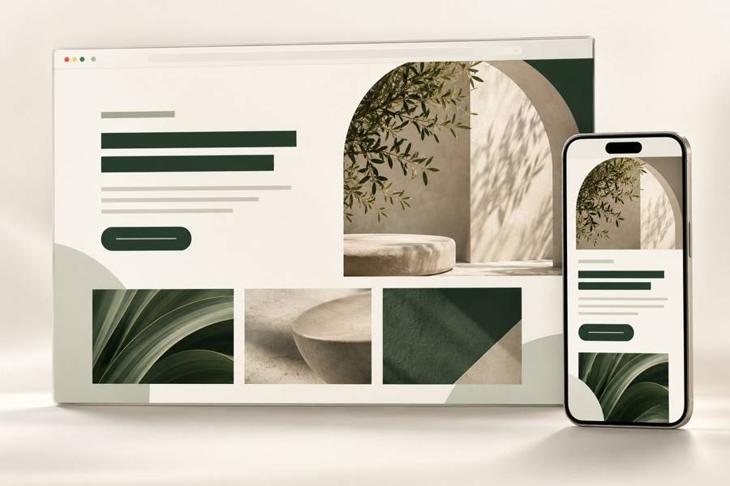
AI PROBLEM DESK
BUSINESS WEBSITE
A clear inquiry path
A focused service website with a useful next step. Explore the live studio demo and its request links.
Fictional business sample. No client results claimed.
02
Notes:
Created demonstration by AI Problem Desk. Cedar Studio is fictional. Generated visual concepts are illustrative. No client testimonial, measured commercial result, or confidential client material is represented. Website: https://aiproblemdesk.com/

Slide 3
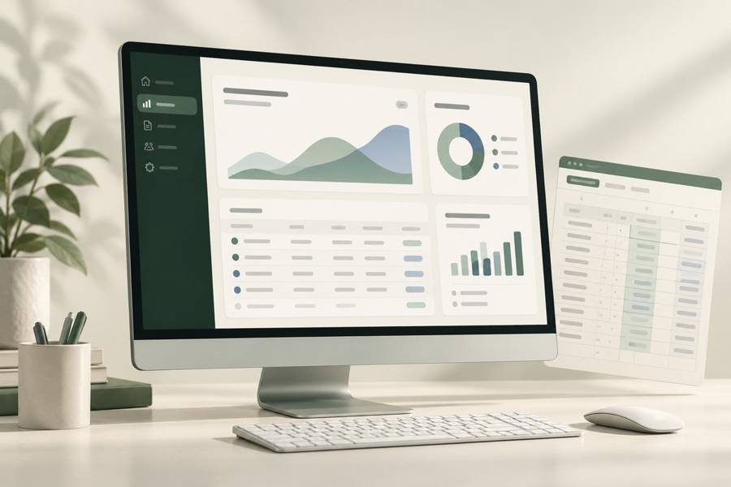
AI PROBLEM DESK
REPORTING DASHBOARD
Numbers you can inspect
Filter a working dashboard using fictional sales data. Totals update from the source rows.
Fictional business sample. No client results claimed.
03
Notes:
Created demonstration by AI Problem Desk. Cedar Studio is fictional. Generated visual concepts are illustrative. No client testimonial, measured commercial result, or confidential client material is represented. Website: https://aiproblemdesk.com/

Slide 4
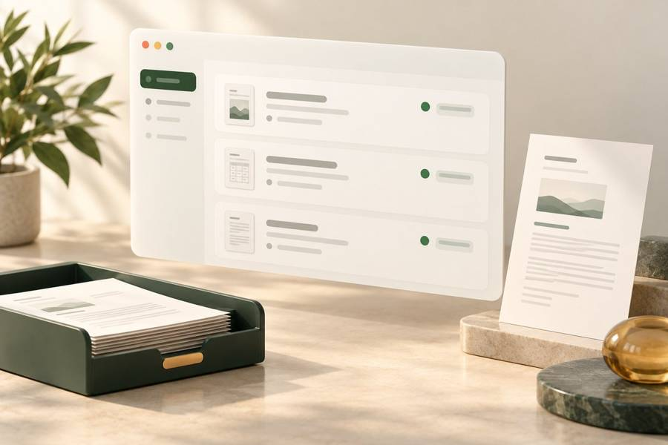
AI PROBLEM DESK
REQUEST WORKFLOW
Approval stays with you
Collect the problem, add files or links, then agree on the work. Sending a request does not authorize execution.
Fictional business sample. No client results claimed.
04
Notes:
Created demonstration by AI Problem Desk. Cedar Studio is fictional. Generated visual concepts are illustrative. No client testimonial, measured commercial result, or confidential client material is represented. Website: https://aiproblemdesk.com/

Slide 5
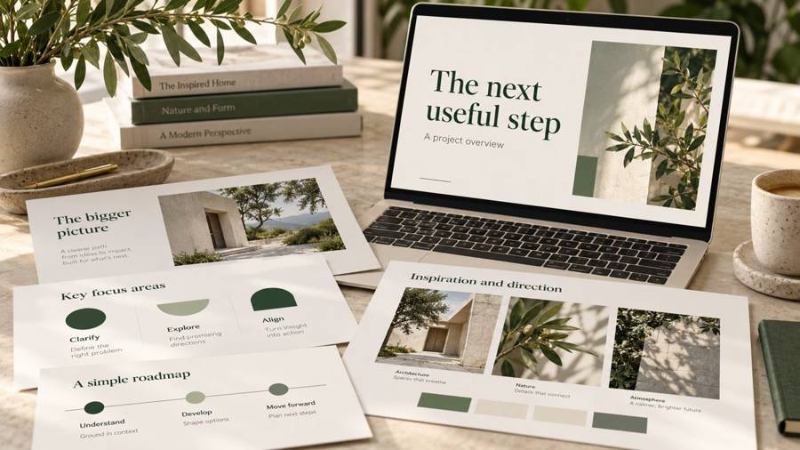
AI PROBLEM DESK
PRESENTATION AND CONTENT
One coherent story
An editable deck and a short visual overview in the same style. Agree on the audience, source facts and output formats.
Fictional business sample. No client results claimed.
05
Notes:
Created demonstration by AI Problem Desk. Cedar Studio is fictional. Generated visual concepts are illustrative. No client testimonial, measured commercial result, or confidential client material is represented. Website: https://aiproblemdesk.com/

Slide 6
AI PROBLEM DESK
YOUR NEXT PROJECT
A useful result starts with a problem
Send rough notes. We clarify by email, agree on scope and price, and review the delivery against your goal.
aiproblemdesk.com/submit
06
Notes:
Created demonstration by AI Problem Desk. Cedar Studio is fictional. Generated visual concepts are illustrative. No client testimonial, measured commercial result, or confidential client material is represented. Website: https://aiproblemdesk.com/

